Slide 1
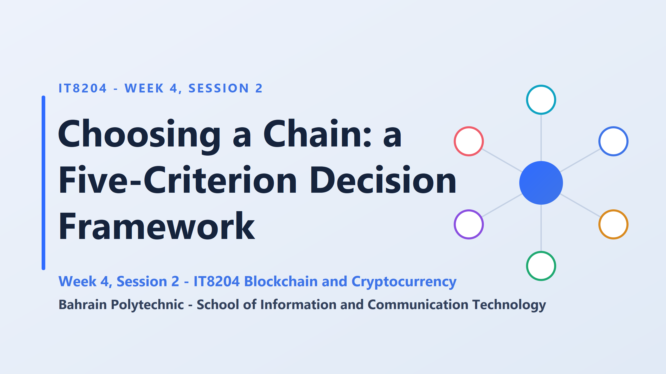
Naming a chain is not an answer.
A real answer names a chain, on stated criteria, for a stated use, and admits the trade-off
Is a pickup truck better than a sports car?
“it depends”. A truck wins for moving furniture, a sports car for speed, a bus for carrying 50 people. Nobody says “just buy the best vehicle”. They ask what the trip is for first. Chains work the same way.

Slide 2
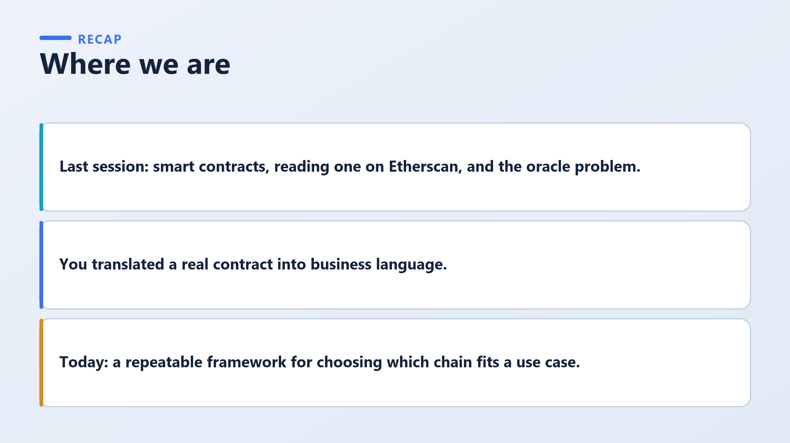

Slide 3
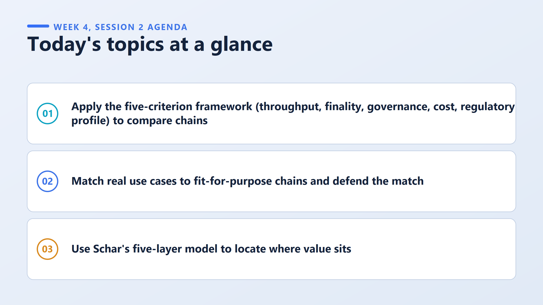
how long until a transaction is permanent and cannot be undone
what it costs to use, such as transaction fees
who makes the rules and can change them
how a regulator or auditor would view the chain
how many transactions the chain can handle per second

Slide 4
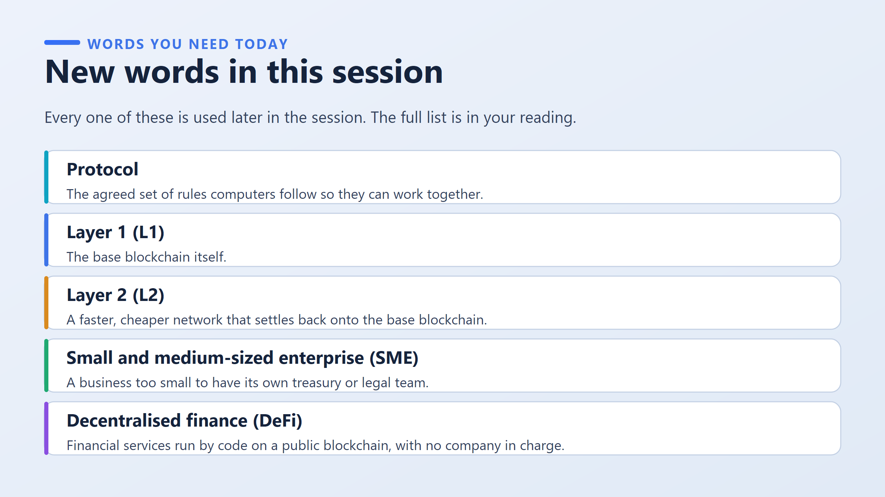
A rulebook. Chess has rules for how each piece moves, and every player follows the same rules so a game can happen. A blockchain protocol is the same: it says how new blocks are made, checked, and accepted. Different chains have different rulebooks, which is why there is more than one chain to choose between.
base blockchain itself, like Bitcoin or Ethereum. It is where transactions are finally recorded
because an SME can't afford experts to check whether a chain is safe, so it needs a simple, reliable way to choose.
Ethereum = roads/infrastructure
DeFi = financial businesses using those roads
OR
Ethereum = provides the platform
DeFi = provides financial applications/services
financial services implemented using blockchain and smart contracts

Slide 5
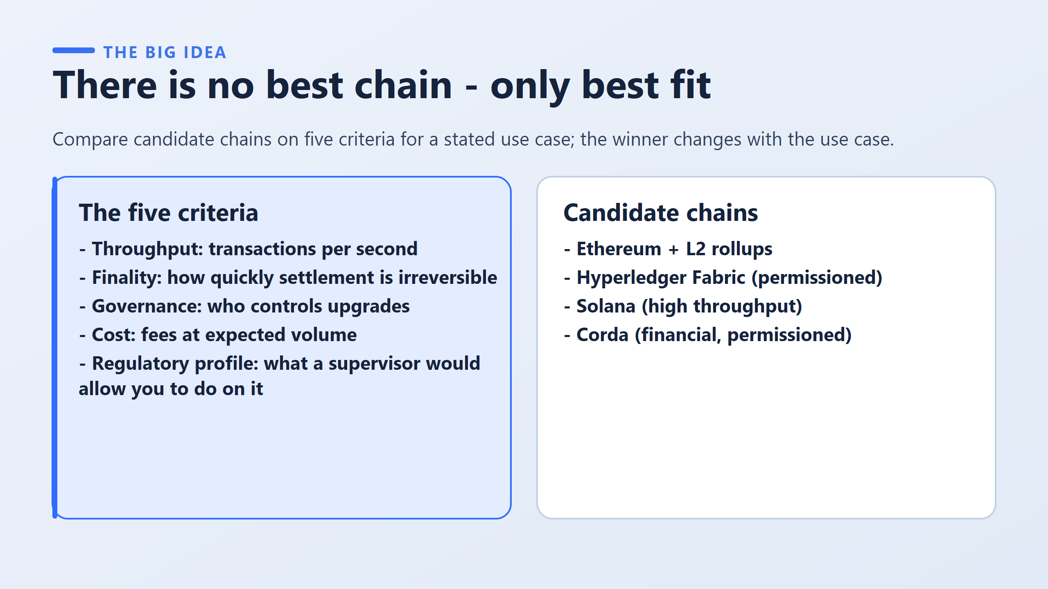
Examples of blockchains that excel in different areas:
Ethereum + L2 rollups: Great for public decentralized apps, offering strong security while using secondary networks (“Layer 2s”) to lower fees and increase speed.
Hyperledger Fabric: A private, “permissioned” network designed for corporate or enterprise use where only approved members can join.
Solana: A public network built specifically for high speed and massive transaction capacity. Corda: A private, restricted network tailored specifically for financial institutions and regulated markets.
To choose the right blockchain
Throughput (Speed & Volume): How many transactions can the network handle per second?
Finality (Permanence): How quickly is a transaction locked in permanently so it can never be undone or changed?
Governance (Control): Who decides when and how the system gets updated or changed?
Cost (Fees): How expensive is it to process transactions when lots of people are using the system?
Regulatory Profile (Compliance): Will government regulators and auditors legally allow you to operate your project on this network?
An analogy for the five criteria
Imagine choosing how to ship a parcel:
Throughput: how many parcels the courier handles per hour
Finality: when delivery is signed for and can't be reversed
Governance: who runs the courier company and can change its rules
Cost: the price
Regulatory profile: whether the authorities allow what you are sending
Nobody asks for the "best courier." They ask what is being sent, how fast, and how much it is worth.

Slide 6
Compare two cases:
Case A: a remittance app sending $20 transfers
Case B: a bank settling $50 million trades
Which criteria matter most for each?
Case A needs low cost and high throughput, and Case B needs fast finality and regulatory acceptability.
Which candidate might fit each?
Solana or an Ethereum L2 for A, and Corda or Fabric for B?
these are starting guesses to be tested, not final answers.
?

Slide 7
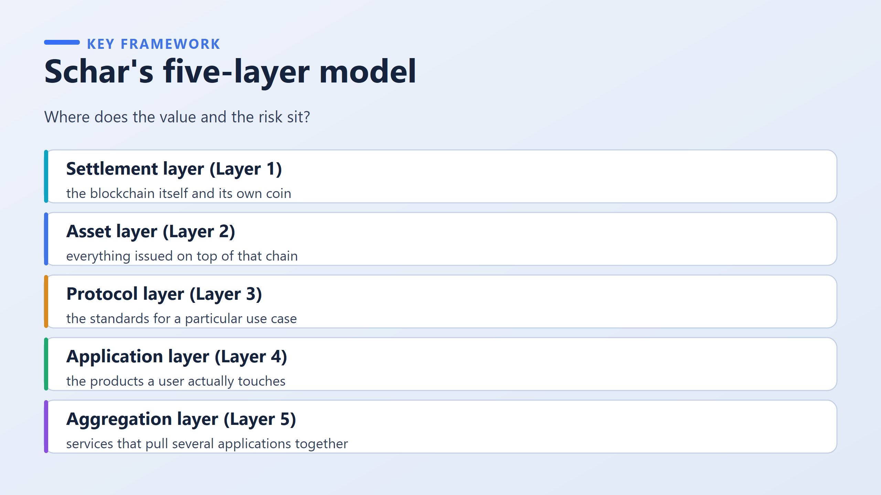
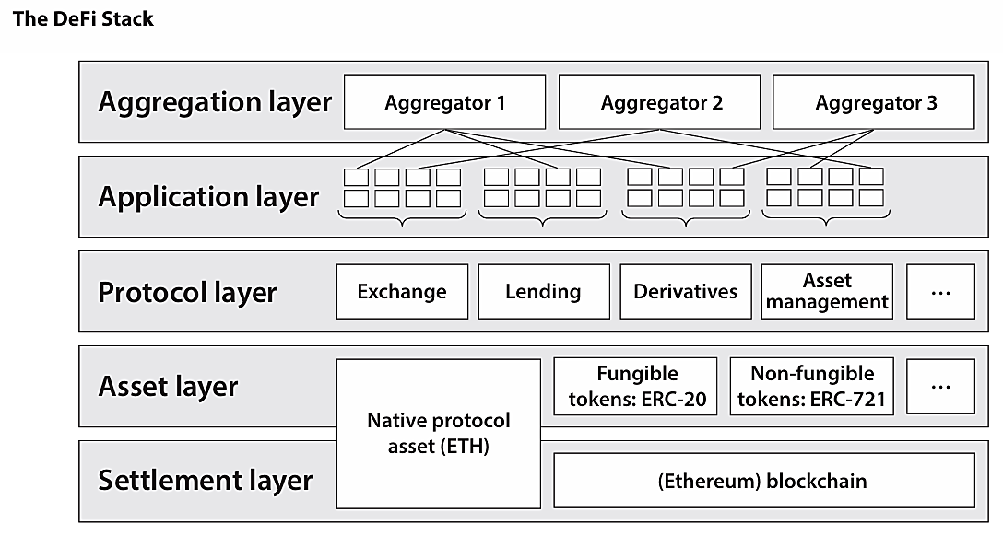
Breaks down Fabian Schär’s Decentralized Finance (DeFi) architecture model into 5 distinct layers to show how different components stack on top of each other, where value is stored, and where risks exist
1. Settlement Layer (Layer 1)
The base blockchain itself and its native cryptocurrency.
The foundation that maintains ownership records and guarantees secure transactions.
Ex: The Ethereum blockchain and its native coin, ETH (or Bitcoin and BTC).
2. Asset Layer (Layer 2)
Everything issued or created on top of that base blockchain.
Custom digital tokens, assets, or NFTs minted on the base network.
Ex: Stablecoins like USDC / USDT, governance tokens like UNI, or NFTs.
3. Protocol Layer (Layer 3)
The rules and smart contract standards for specific financial use cases.
The underlying backend logic and smart contracts that define how financial activities work (e.g., lending, borrowing, or trading).
Ex: Uniswap (liquidity pool smart contracts) or Aave (decentralized lending protocol).
4. Application Layer (Layer 4)
The products and user interfaces a user actually interacts with.
The front-end website or mobile app interface that lets users easily interact with the underlying protocols without writing code.
Ex: The app.uniswap.org website, MetaMask interface, or web dashboards for lending platforms.
5. Aggregation Layer (Layer 5)
Services that connect multiple applications together into one place.
Platforms that search across different Layer 4 applications to find you the best prices, highest yields, or combine multiple services in one dashboard.
Ex: 1inch (searches across exchanges to find the best swap price) or Zapper / Zerion (tracks your entire crypto portfolio across multiple DeFi apps).

Slide 8
The Banking App Analogy
Imagine your phone app says you have $0 in your bank account, but you know you should have $1,000.
Before you can fix it, you have to figure out where the failure actually happened:
Was it just the app software (Application Layer)?
Scenario: The app crashed or had a visual glitch, but the bank’s main computer still shows your $1,000 is safe.
How to fix it: Re-install or update the phone app. The underlying system was fine.
Was it a policy/contract rule (Protocol Layer)?
Scenario: The app worked fine, but an automated bank rule incorrectly triggered an overdraft fee or froze your account.
How to fix it: Rewrite or appeal the rule/contract logic.
Was it the central banking network itself (Settlement Layer)?
Scenario: The entire national banking system went offline, or someone hacked the master ledger that keeps track of everyone’s money.
How to fix it: No phone app update can save you. The foundational platform itself failed.
The Main Idea: You can’t fix a problem until you know which layer caused it. Updating a phone app won't help if the master bank ledger was destroyed.

Slide 9
Upgrades Controlled by Outsiders
Imagine a company in Bahrain decides to run its digital payments on a public blockchain network like Ethereum.
The Concern: Suppose developers or validator node operators in the US or Europe vote to change the base rules of that blockchain (e.g., changing transaction fees, altering consensus mechanisms, or enforcing rules that conflict with Bahrain's local regulations).
Which layer is that?
Settlement Layer (Layer 1): The rules being changed belong to the base blockchain network itself, where transactions are permanently written and verified.
Which criterion from the previous slide does it match?
Governance: The previous slide defined Governance as "who controls upgrades".
Why does this matter? If the company in Bahrain doesn't like those base-level changes, editing their own application code won't help.
Because the control rests with external developers/validators at Layer 1 (Settlement), the company's only fix is to migrate off that blockchain entirely and pick a candidate chain with local or permissioned governance (like Hyperledger Fabric).

Slide 10
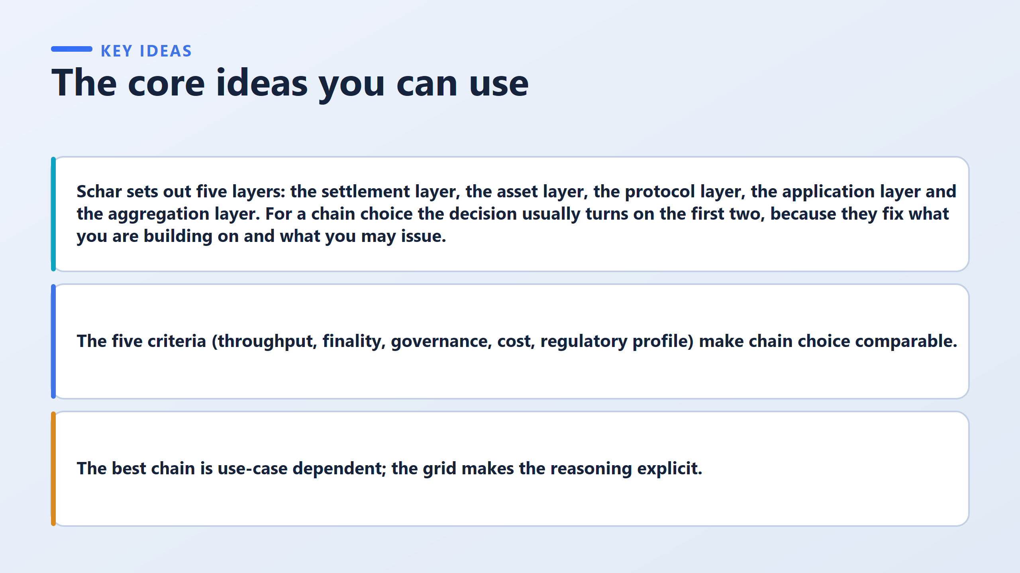
Two teams choose different chains for the same payment corridor:
Team A weighted cost most heavily and picked a cheaper public chain.
Team B weighted regulatory profile most heavily and picked a permissioned chain.
Both can be defended, because the weights are stated.
"Which team is right?"
The answer is neither is wrong. The real question is: “Which weighting suits the firm’s situation?” That is the main lesson of the day.

Slide 11
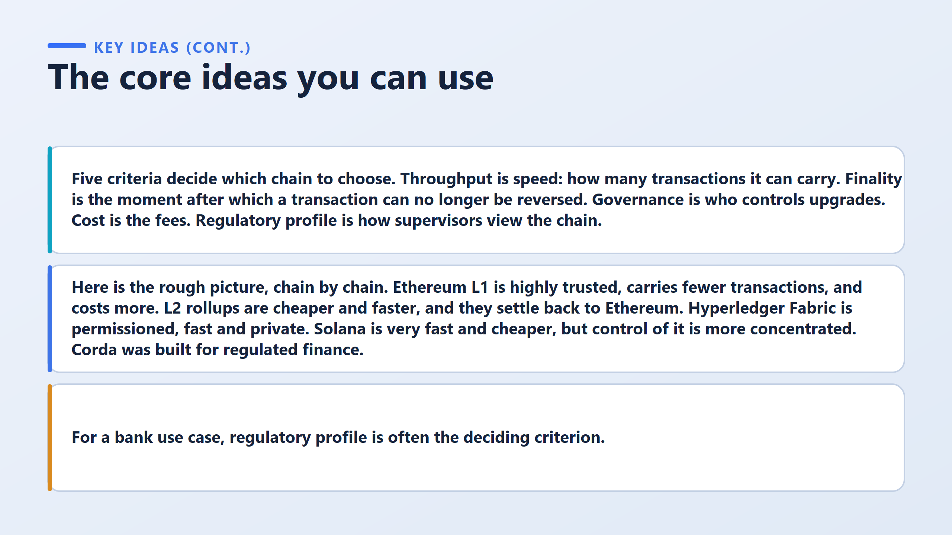
Why: A chain can be as fast and cheap as Solana or as secure as Ethereum, but if government regulators won’t legally allow a bank to put customer data or financial assets on a public, permissionless network, those speed and cost advantages don’t matter. The bank must choose a regulated or permissioned alternative like Corda or Hyperledger.

Slide 12
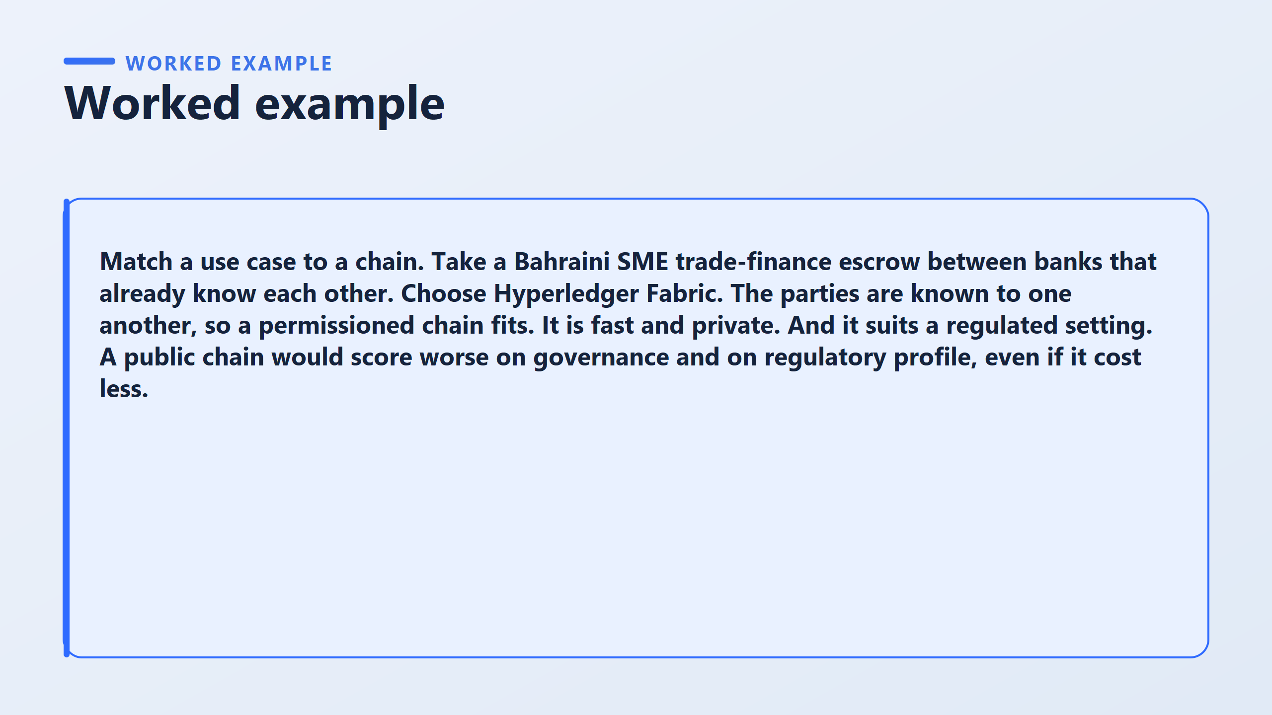
Hyperledger Fabric is the best fit for this scenario. Here is why:
Permissioned Access: Because the banks already know each other, they don’t need a wide-open public network like Bitcoin or Ethereum. They only need a private network where access is strictly controlled.
Speed & Privacy: Hyperledger Fabric is fast and keeps transaction data confidential between the participating banks.
Regulatory Compliance: It fits neatly into a strict banking regulation setting where data privacy and compliance are mandatory.
Why Not Use a Public Blockchain?
Even if a public chain (like Ethereum or Solana) were cheaper or easier to launch, it would lose on two crucial criteria:
Governance: On a public chain, random anonymous global nodes control network upgrades rather than local banking authorities.
Regulatory Profile: Local financial regulators will not allow sensitive, local customer or bank transaction data to be broadcast on a public ledger.
evaluate a specific business problem against the 5 criteria to pick the right blockchain

Slide 13
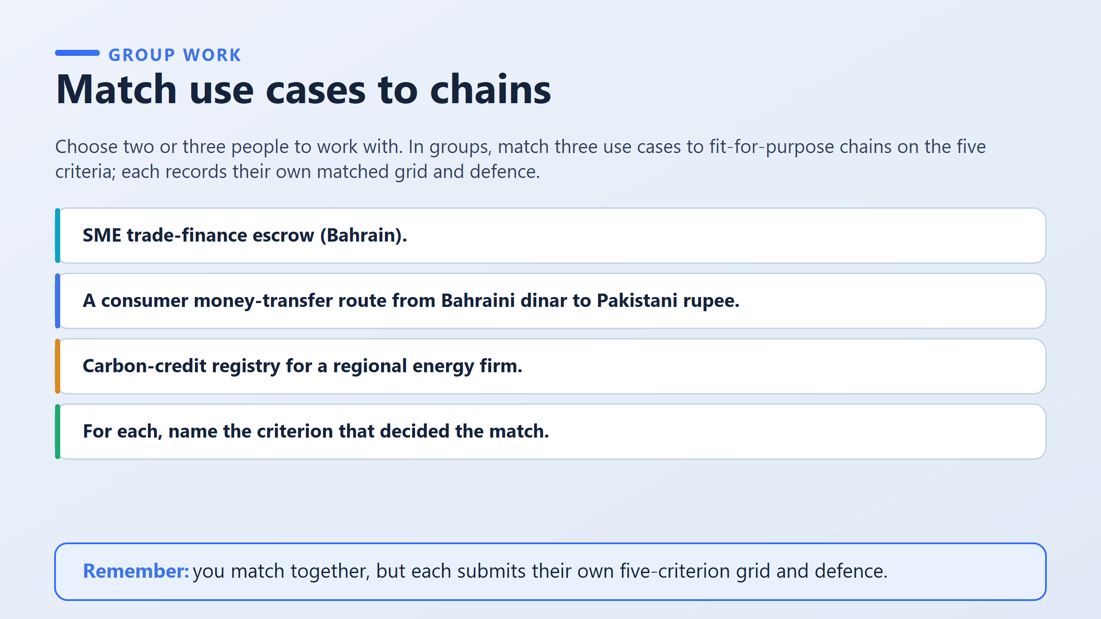
You can solve each of the three use cases based on the 5 criteria

Slide 14
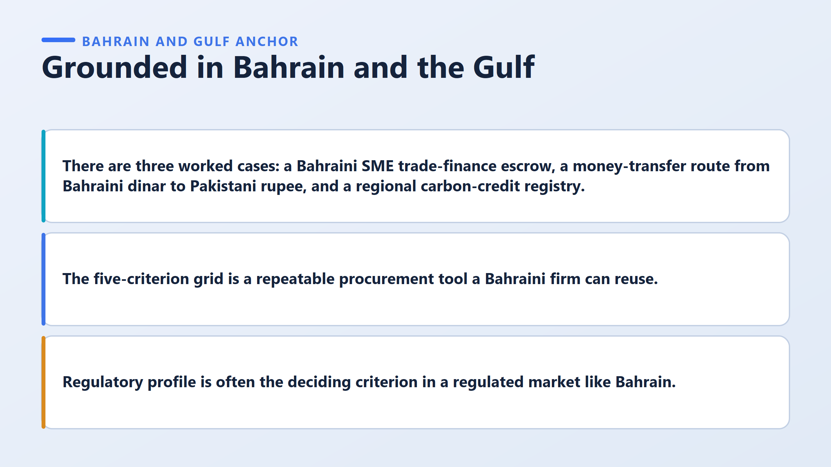

Slide 15
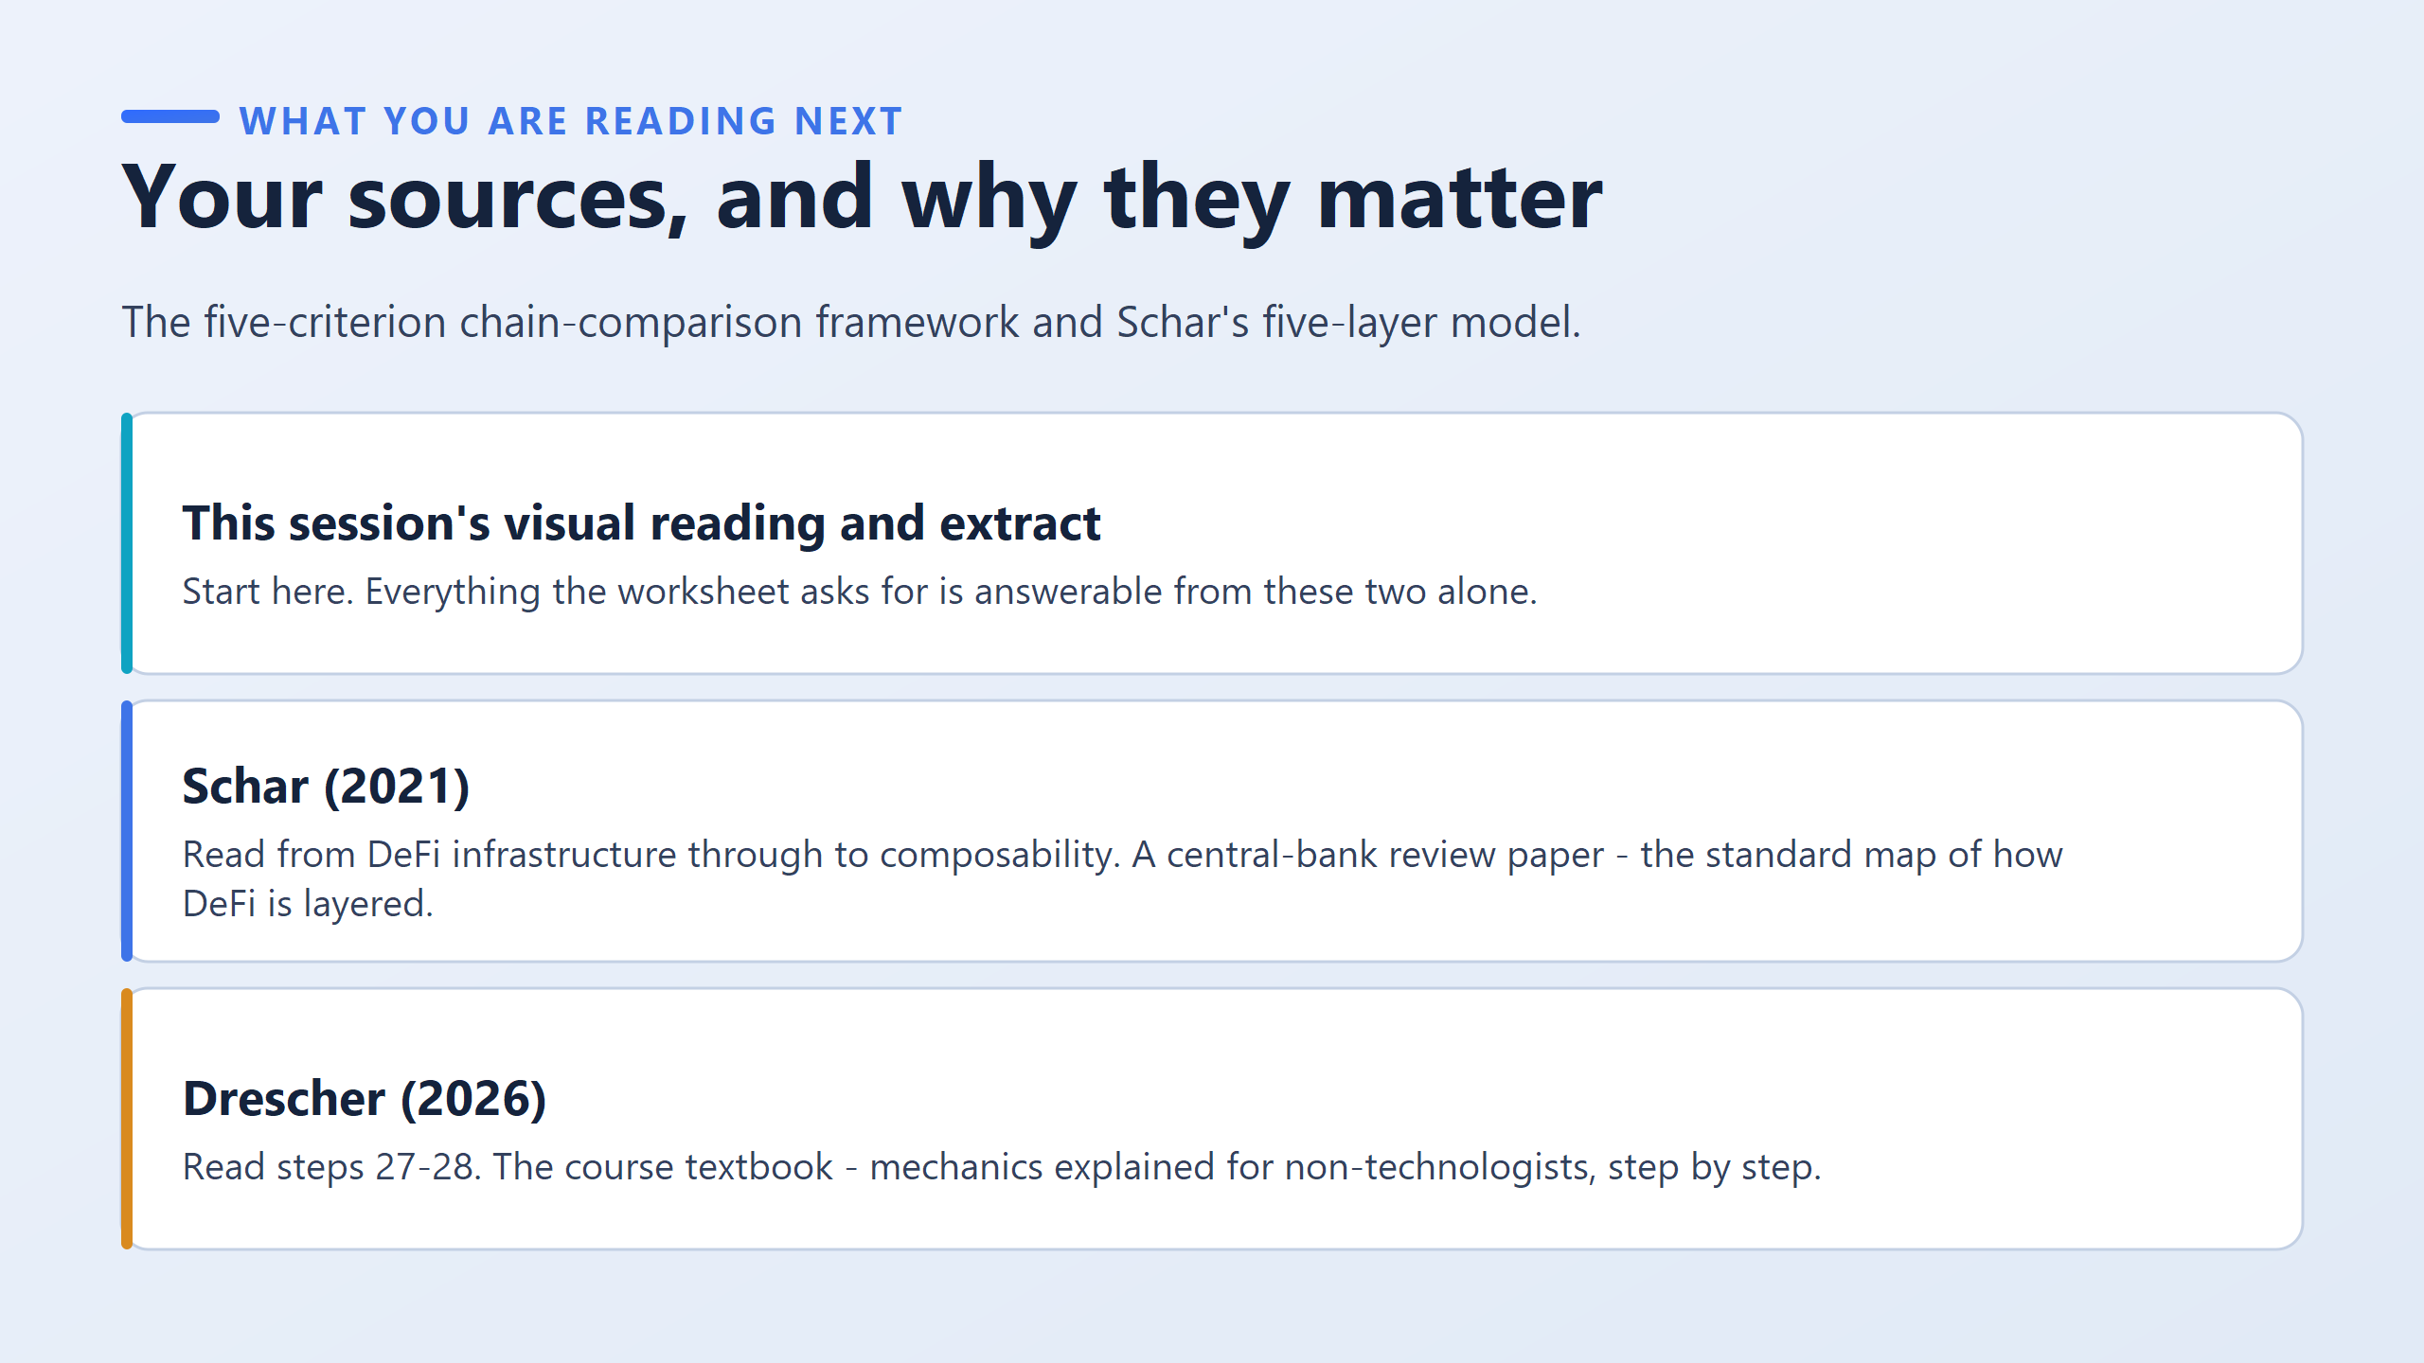

Slide 16
